Slide 1
Supply Chain Management

Slide 2

Supply Chain Management By:-
Sarvesh Joshi
Alena Ranjan
Sirish Reddy
Snehal Polaswar
Himanshu
Sparsh Kaur Ochani
Mr. Vishal
Snehal Polaswar
Sarvesh Joshi
Alena Ranjan
Shaik Abdul

Slide 3

Agenda
Total Sales (YTD,MTD,QTD)
Store wise Sales
Sales growth
Daily sales trend
Brand wise sales
Gross Profit
Product in inventory
Over stock, out of stock, under stock
Inventory value
Region wise sales
Total profit, profit margin and unique orders by region
Total profit by region

Slide 4
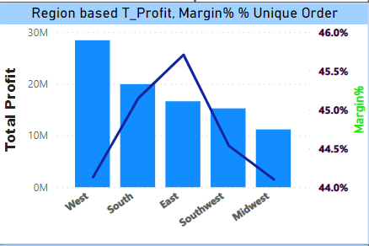
Region based profit, margin% unique orders :-
Each regions profit, % margin profit and unique orders.

Slide 5
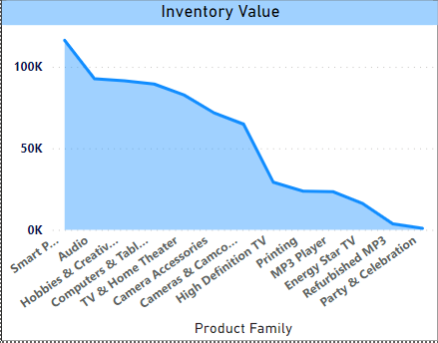
Inventory Value :-
Investment on inventory by item category.

Slide 6
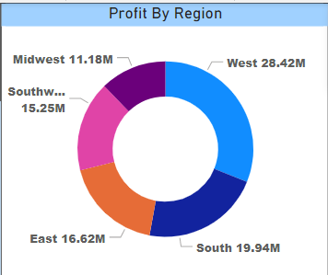
Profit by Region :-
Profit per region to know which region is important in business prospective.

Slide 7
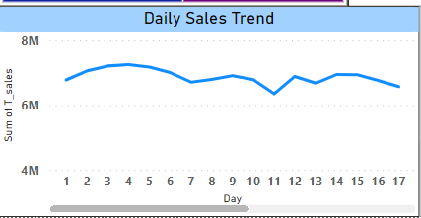
Daily sales trend :-
Day to day sales data to evaluate which days of the week are crucial for the business.

Slide 8
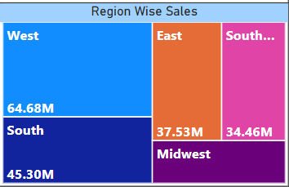
Region wise sales :-
Region wise sales which give us information that which region is performing good and which need to look after for improvements.

Slide 9
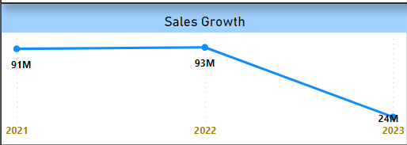
Sales growth :-
Sales growth over the year to decide financial growth of the organization.

Slide 10
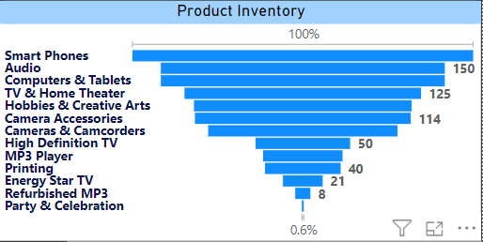
Product Inventory :-
Which product is more in stock and which is less in stock can be managed by this visualization

Slide 11
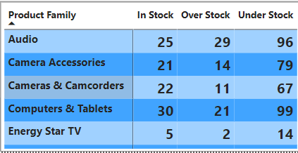
In stock, over stock, under stock :-
This will give us clear picture of the stock data and help to maintain inventory to serve customer without any hiccups

Slide 12

Conclusion:-
Power Bi, Tableau & Excel when combined with business intelligence suites, data visualization tools for supply chain management analytics help managers operate better by providing real-time information that can support decisions and deliver actionable insights.

